Slide 1
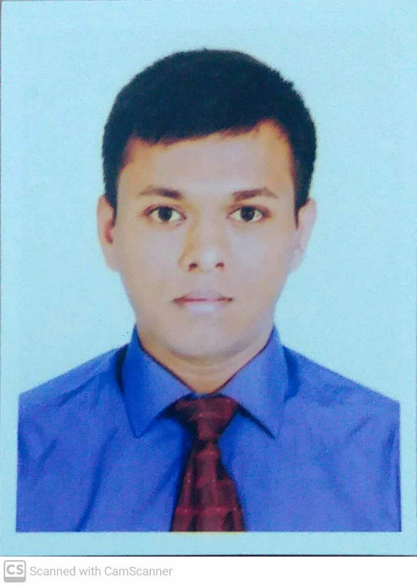
WASIF ZAHIN Summary i I am Wasif Zahin. I graduated from department of CSE, KUET. I am acknowledged in Data Science. I am also expert in web development. Skill Highlights d Data Analysis Project Management Project Supervision Creative Design Web Development Experience h Web developer in Tiger IT from 08/09/2022 to 09/09/2023. Project manager in Lara IT 08/11/2023 to 09/01/2024 Education h BSc. In CSE, KUET Intermediate in Notre Dame College, Dhaka Ideal School & College from Class 1 to 10 Languages h English Bangla Arabic
 | Contact Address : Kabirpur, Ashulia, Savar, Dhaka Phone : +8801902703327 Email : wzf8801@gmail.com

Slide 2
Hobbies h
Cooking
Fishing
Coding
Program Management
Certificates m
Regional Champion (Dhaka) in Math Olympiad 2012
Project Manager of the month of December,2023 in Lara IT

